Slide 1

Department of Information Technology
A.P. Shah Institute of Technology G.B.Road,Kasarvadavli, Thane(W), Mumbai-400615
UNIVERSITY OF MUMBAI
Academic Year 2020-2021

Slide 2
A Project Report on
Public Cloud Storage with Enhanced Security
Submitted in partial fulfillment of the degree of
Bachelor of Engineering(Sem-8) in
INFORMATION TECHNOLOGY
By
Prabhanjan Amare 15204039
Vaishnavi Rathod 15104051
Under the Guidance of Prof.Apeksha Mohite Prof.Yaminee Patil

Slide 3
1.Project Conception and Initiation

Slide 4
1.1 Abstract
We are working with honey and homomorphic encryption algorithm.
When user saving file on cloud it is not secured, on some applications system admin can view files, but our approach is to encrypt file on server with key it means whenever user will upload file on server he/she need to pass one key.
This key may user can use as a unique key or same, after successfully uploaded file on server one email will shoot to user with file and its key for future ref and file will get ency and stored on server.
If user want to retrived file again then simply he/she need to submit key before downloadng if key matches then successfully download file else one email will shoot to user alert user.and some wrong file will get download.

Slide 5
1.2 Objectives
There are three main objectives for this proposal. The objectives are
To study a method that can secure of data replication database server.
To implement encryption algorithm technique in data replication.
To study encryption and decryption of data replication by using AES

Slide 6
1.3 Literature Review
Data replication is one of the methods to manage huge resources of data as it enhances reliability and data access (Noraziah, Azila, Fauzi, Mat & Mohd, 2011). Replication is one of the phenomena happened in the distributed environments which have multiple copies of data are stored at multiple site (Bahareh Alami Miani & Nima Jafari Naimipour, 2017).
Data storage security refers to the security of data on the storage media and that‟s why security is an important factor in cloud computing for ensuring clients data is placed on the secure mode in the cloud (Amandeep Kaur & Sarpreet Singh, 2013). In this paper, they secured storage scheme by implement Twofish and RSA and user can insert any form of data. After that, the data will be stored in in Windows Azure Cloud. The advantages for having these algorithm are reduces data lost and the aligned of security increases.

Slide 7
1.4 Problem Definition
Data replication show the synchronizing data across multiple remote databases simultaneously ensures business critical information is close at hand should disaster strike. This enables your enterprise to be up and running as quickly as possible, reducing productivity and revenue losses, as well as limiting reputational damage.
The advantages of having replication are saving times as the system have backup. So,
no need to turn the system down if sudden damage happened.
In terms of security, it is important to encrypt the information in the database as it
increase privacy and security.
Data Encryption give the potentiality to encrypt data for both transmission which are against non-protected networks and for storage on media

Slide 8
1.5 Scope
The scope of this project focused on encryption of data replication using Advanced Encryption Standard (AES).
The proposed system will provide security beyond conventional brute-force bounds which will provide better confidentiality of data as these will make unauthorized accessing of data difficult for nonlegitimate users.

Slide 9
1.6 Technology stack
LAMP is an open source Web development platform that uses Linux as the operating system, Apache as the Web server, MySQL as the social database administration framework and PHP as the object-oriented scripting language.
Sometimes Perl or Python is used instead of PHP.
This paper had decided to use MySQL as a database server.

Slide 10
1.7 Benefits for environment & Society
Cloud computing offers many benefits. It allows you to set up what is essentially a virtual office to give you the flexibility of connecting to your file anywhere, any time. With the growing number of web-enabled devices used in today's business environment (e.g. smartphones, tablets), access to your data is even easier.
Most all of the cloud services come with an easy-to-use user interface and provide a
feature of drag and drop.

Slide 11
2. Project Design

Slide 12
2.1 Proposed System
In this project, an encryption algorithm is needed to ensure the security of data replication between two databases server.
Thus, AES (Advanced Encryption Standard) algorithm is used to secure data replication as it is a type of symmetric block cipher which is encrypt data on a per- block.
It is important because AES require less resources and faster than asymmetric block cipher and also suitable to encrypt the original data

Slide 13
2.2 Design(Flow Of Modules)
AUTHENTICATION
DATA STORE
USER/CLOUD
SERVER
REGISTER LOGIN
HOME
DATA STORE
BROWSE
UPLOAD DOWNLOAD
CLOUD SERVER
DATA STORE
KEY GENERATE

Slide 14









2.3 Description Of Use Case
registration
login
Generate a security key
DATA OWNER
Enter security
key
Upload a file
Download a file

Slide 15





2.4 Activity diagram
Login
Browse
Upload file Key generate for
Downloading file
View the file

Slide 16









2.5 Sequence Diagram
ADMIN
USER
REGISTER
LOGIN
UPLOAD FILE
CLOUD STORAGE
DATABASE
User register
User login
User upload file
Store the file on cloud
ADMIN LOGIN
Information store
Admin data store
Add to database

Slide 17

2.7 Module-1

Slide 18
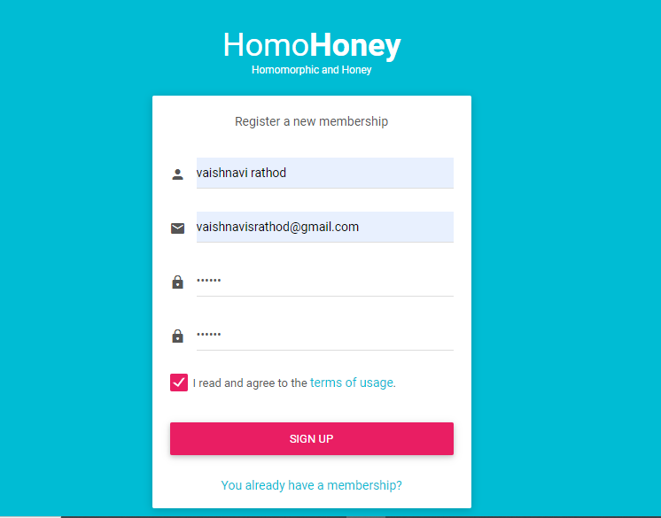
Module-2
Registration

Slide 19
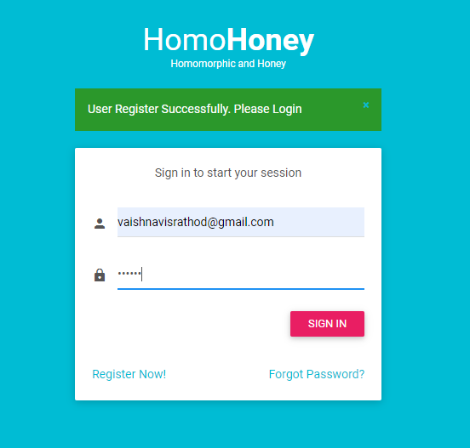
Module-3
Login

Slide 20
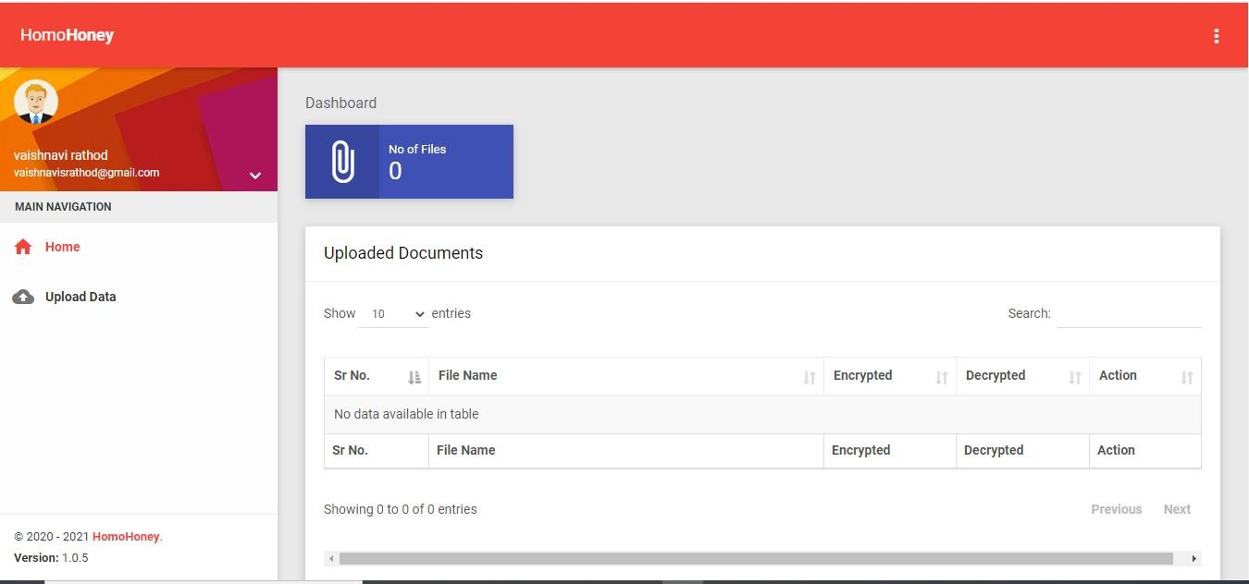
Module-4
Home page

Slide 21
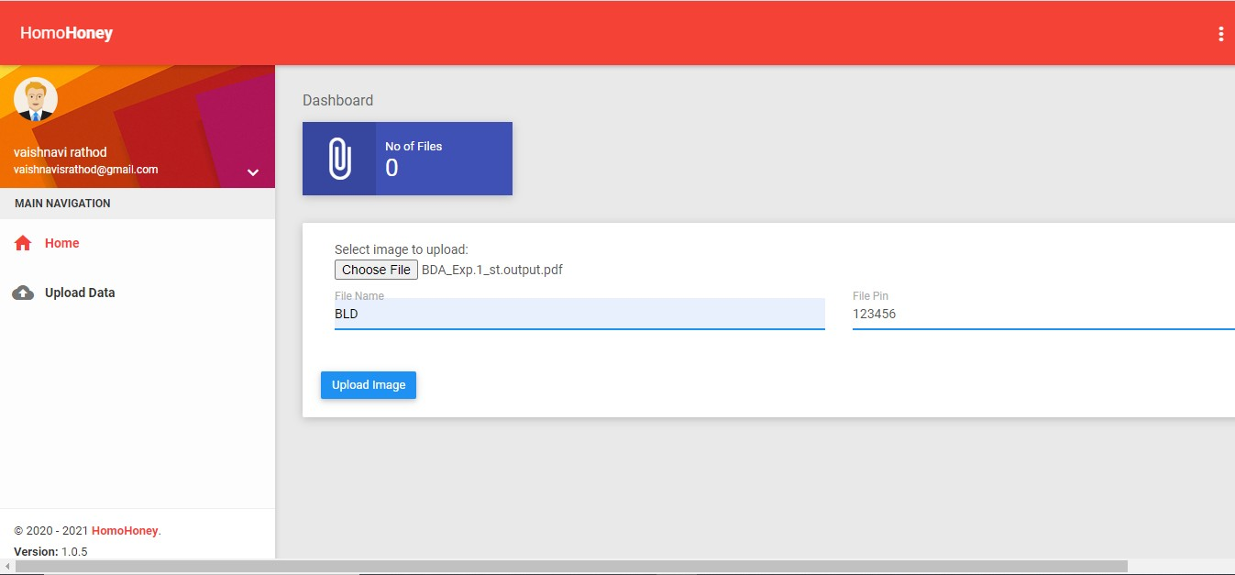
Module-5
Choosing file and assigning password to the file

Slide 22
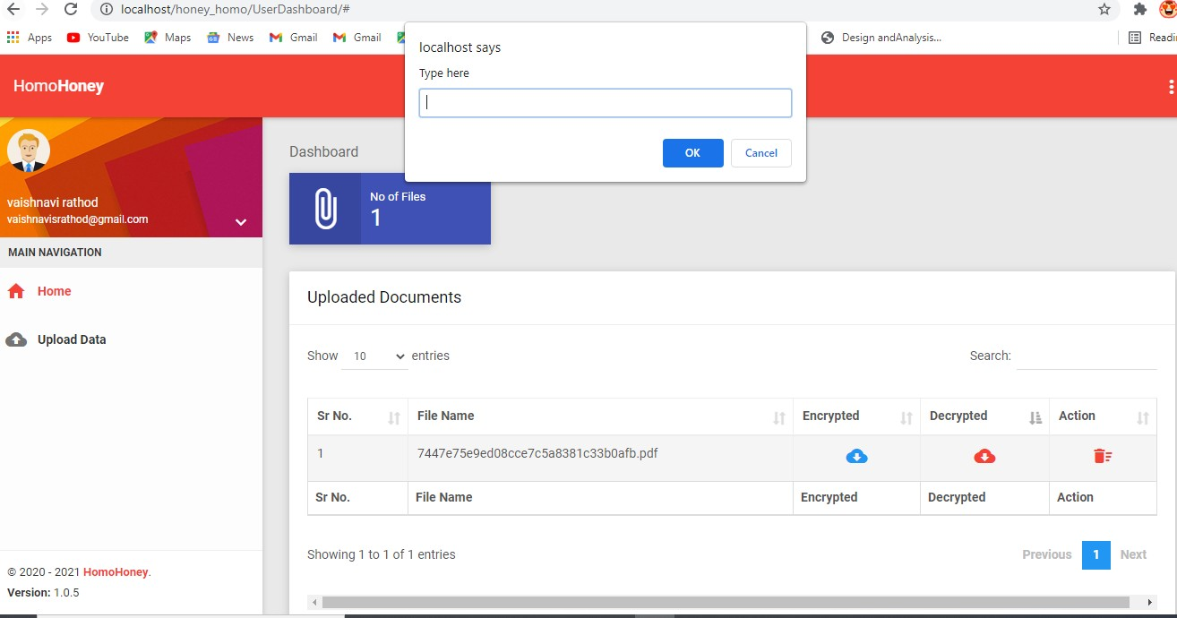
Module-6
Downloading encrypted file where password is needed

Slide 23
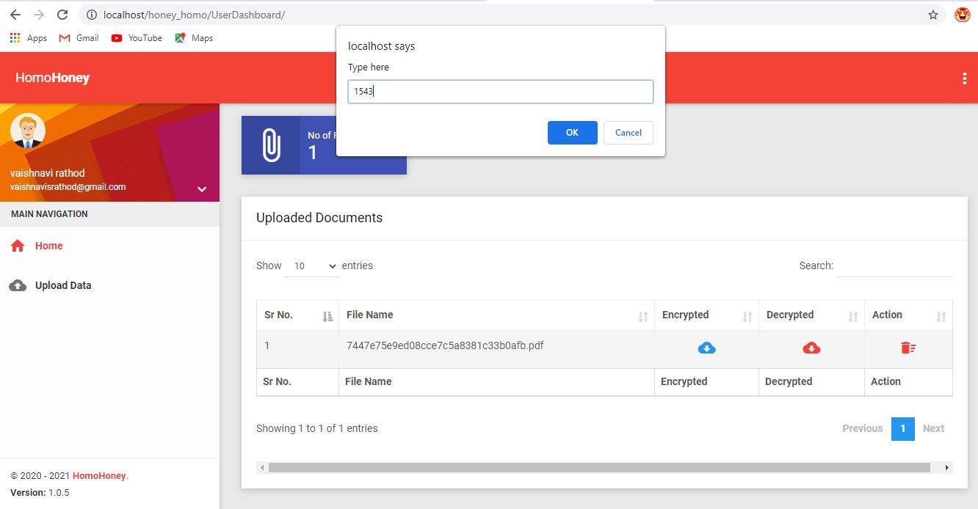
Module-7
Providing wrong password

Slide 24
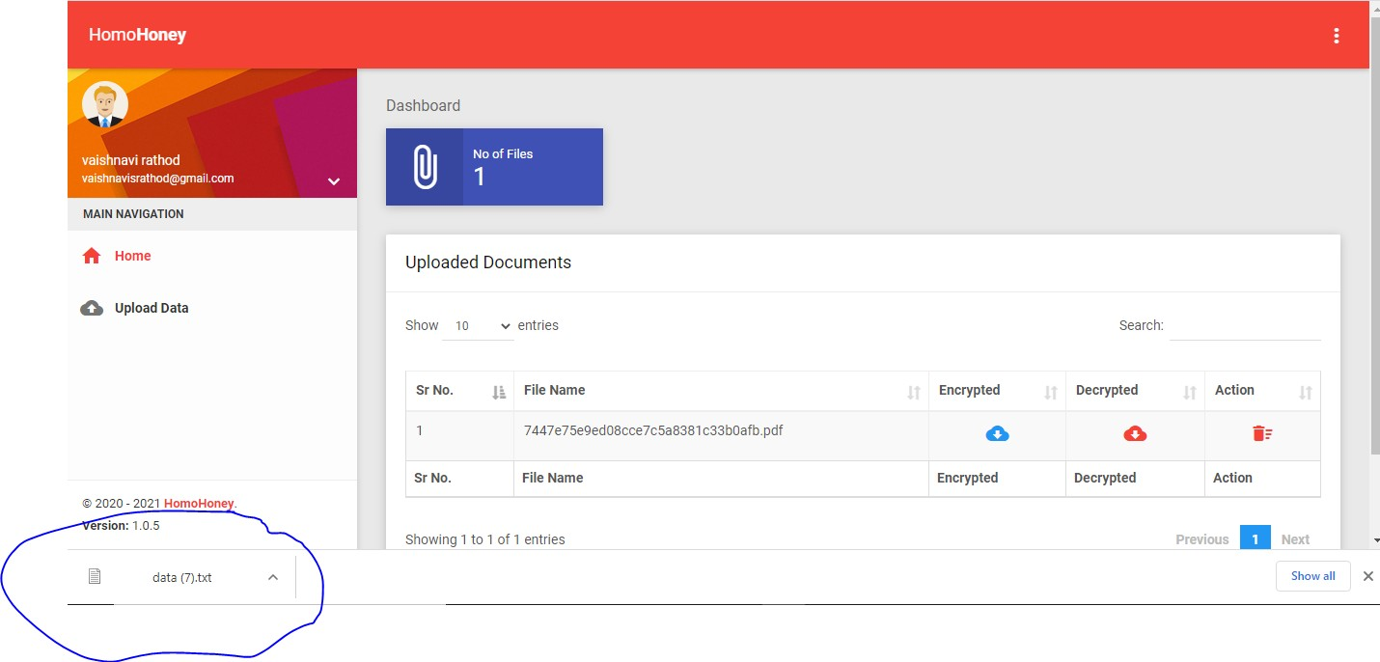
As a result wrong file gets downloaded

Slide 25
3. Conclusion and Future Scope

Slide 26
3. Conclusion and Future Scope
Data replication is more secured by using AES as AES provides a strong level of security. To prevent the data sent through the unsecured channel, data encryption is very useful. Encryption turns the readable data into unreadable form. Data becomes useless since people do not understand. To retrieve the encrypted data, user must have the key to perform decryption.
In this project, for the future work, the data replication will be real time processing. Since we use the scripting which need tobe run before data replication happens which is manually and not real times. Maybe in the scripting, it can be set the time whenever changes have been made in master database, the slave will be automatically gain the changes at the same time. So that, the data replication process will be more real times.

Slide 27
4.Reference

Slide 28
2.8 References
William Stallings, Cryptography and Network Security Principles and Practice, seventh edition, 2017.
Beg, A.H, Noraziah, A.Abdulla, A.N and Rabbi, K.F, Framework of Resistance layer synchronous replication to improve data availability into a heterogeneous system, international journal of computer theory on engineering, 5(4), 611, 2013.
Nidhi Singhal and J.P.S.Raina, Comparative analysis AES and RC4 for better Utilization, International Journal of Computer Trends and Technology, July to Aug Issue 2011.
M.Pitchaiah, Philemon Daniel and Praveen, Implementation of Advanced Encryption Standard (AES) Algorithm, International Journal of Scientific & Engineering Research Volume 3, Issue 3, March, 2012.

Slide 29
Thank You

